Slide 1
IAPR -Project
Nicolas Feppon
Victor Dramé
Nicolas Martinod
■
03/06/21

Slide 2
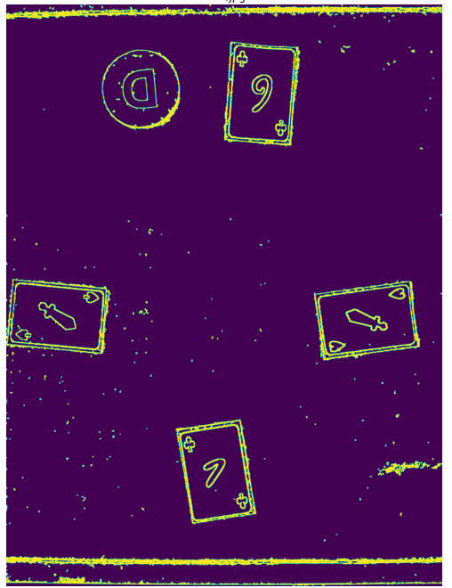
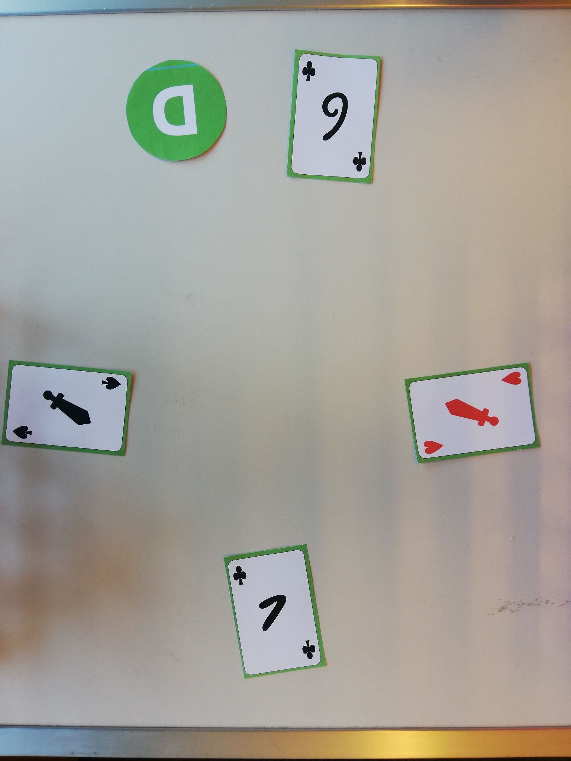
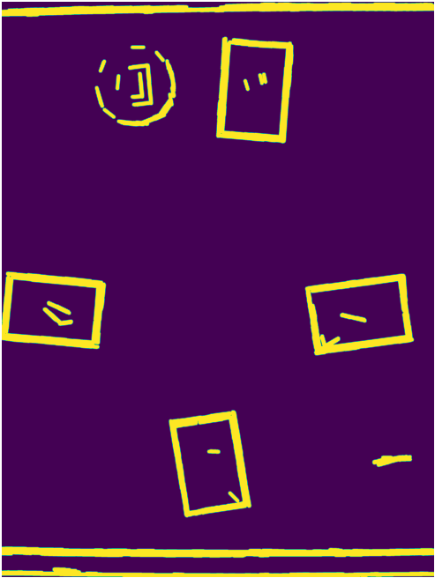
Data preprocessing
Raw image processing to underline contour
Blur -> Canny -> Threshold -> Dilate
Original
Blur -> Canny -> Threshold -> Dilation -> Hough

Slide 3
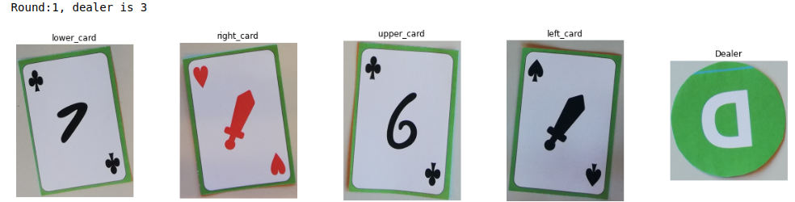
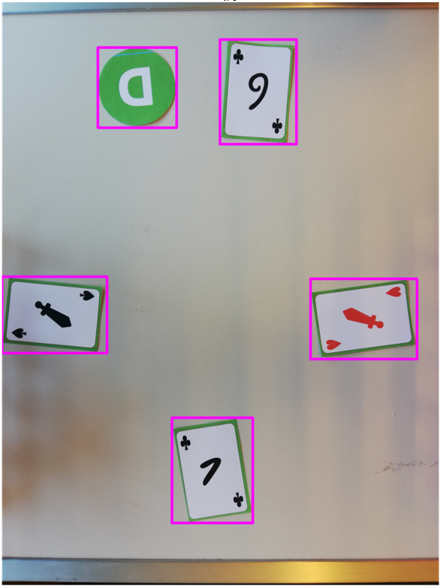
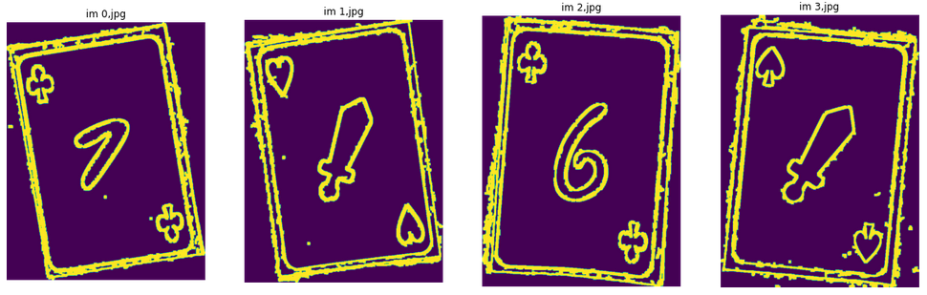
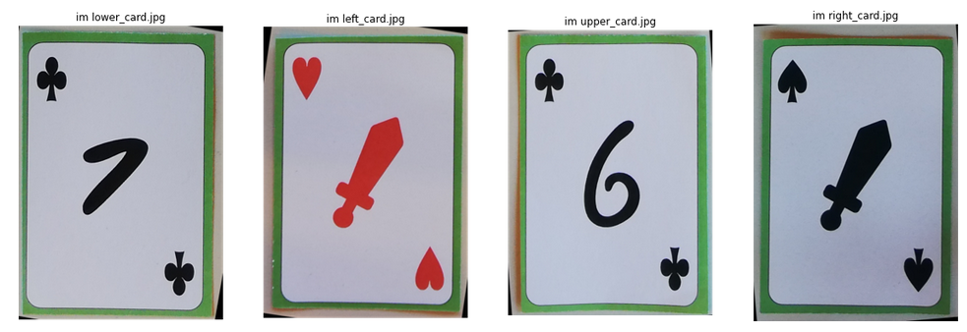
Data preprocessing
1
2
3

Slide 4
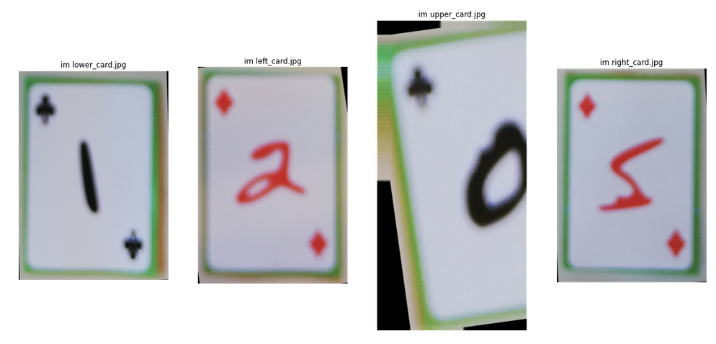
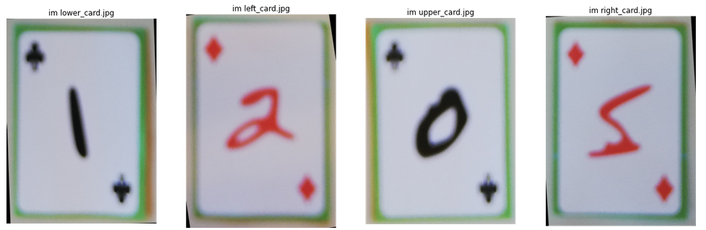
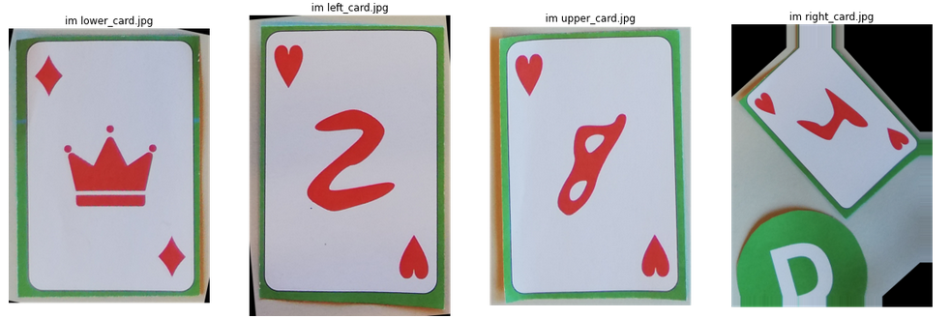
Data preprocessing
Hough Transform impact
Line consideration
Better blur resistance
still some issues with images close to dealer (2 issues over 364 samples)
Card retrieved without Hough line
Card retrieved with Hough line

Slide 5
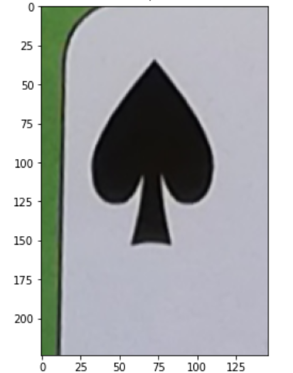
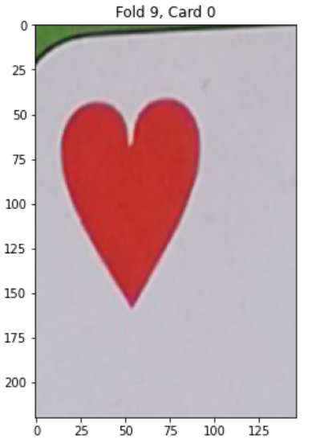
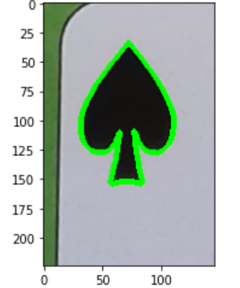
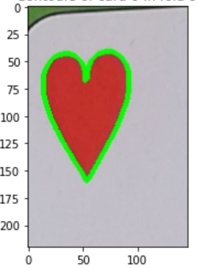
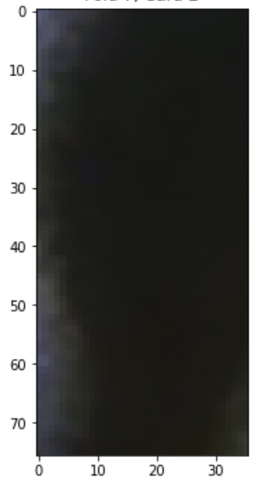
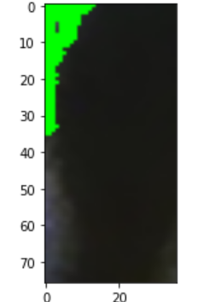
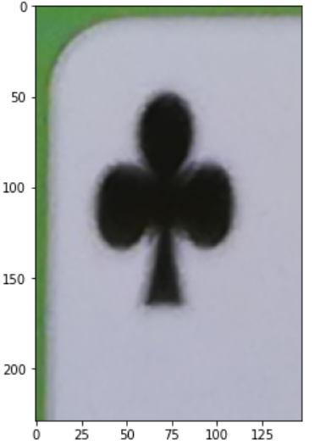
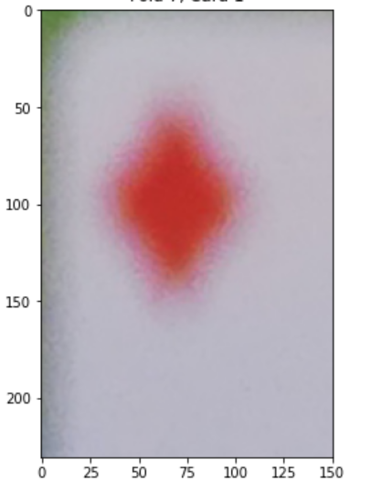
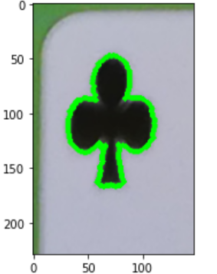
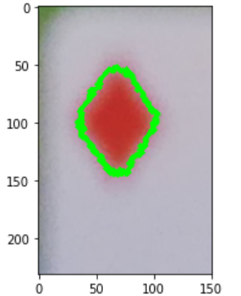
Suit prediction
Extraction of the top left corner of the card image for suit prediction
Passing to gray scale image, High pass filtering 3x3, and thresholding for contour extraction

Slide 6
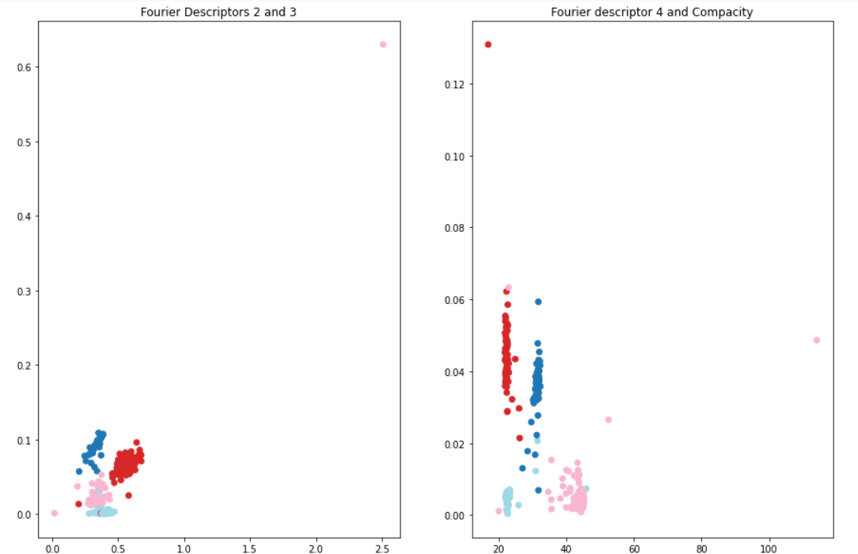
Suit prediction
Computation of features of the contour in order to train a classifier:
Normalized Fourier Descriptors 2, 3 and 4 and Compacity
Random Forest classifier with 20 trees trained on the features, accuracy of 0.942 when taking game 3 as validation set

Slide 7
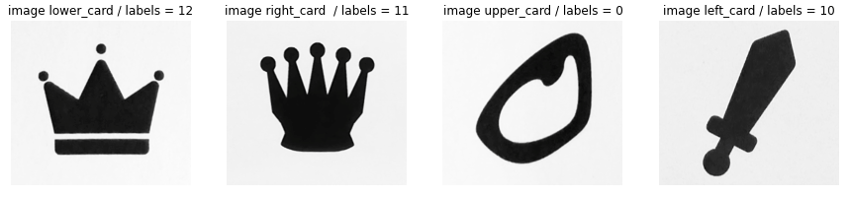
Rank prediction
Train a CNN classifier on the cropped images of rank symbols
Dataset preprocessing :
Shuffle cards
Pixel normalization
Convert to gray image
Use 80% for training, 20% for validation
Apply data augmentation on training set (shear, rotate, shift, brightness

Slide 8
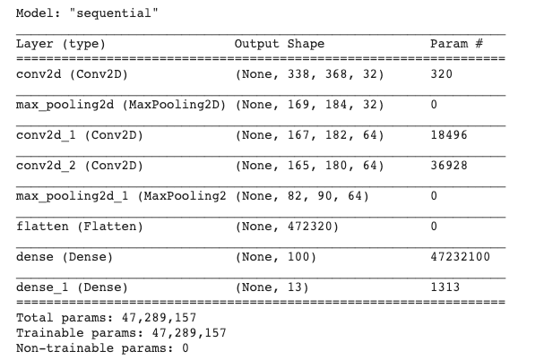
Rank prediction - CNN model
Optimizer: Adam Loss: categorical crossentropy Activation function: Relu, except Softmax
for classification layer

Slide 9
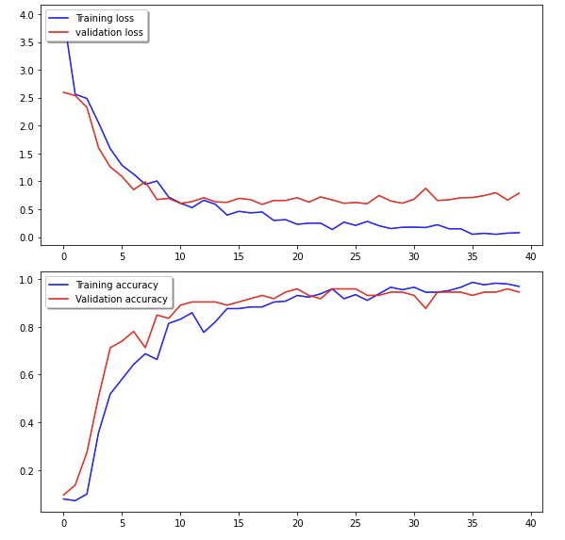
Rank prediction - Accuracy & Loss

Slide 10
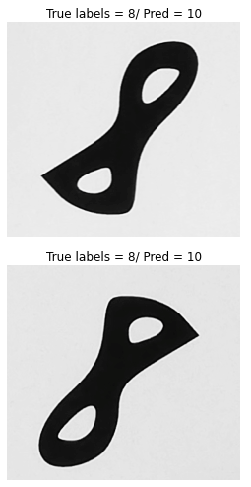
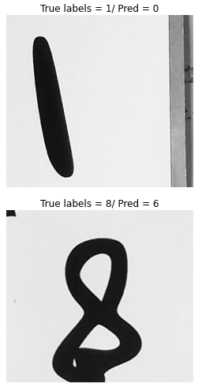
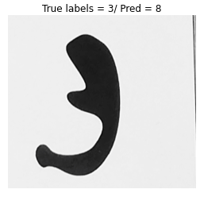
Rank prediction - Limitation

